Slide 1
BUS STOP SIMULATION
Submitted by:
Kavuturi Deva Bhargav (ENG17CS0107)
Kiran M (ENG17CS0111)
Manoj Kumar D (ENG17CS0122)
Manojkumar M Mangalore (ENG17CS0124)
Submitted To :
Prof.Ranjitha G
Assistant Professor

Slide 2
Table Of Contents
ABSTRACT
INTRODUCTION
TOOLS USED
MODULES
SNAPSHOTS / OUTPUTS

Slide 3
Abstract
The aim of our project is to demonstrate the motion of bus between bus stop and university, where it carries the students who are waiting to travel from the respective bus stop to the university. When the bus arrives to the bus stop the students board the bus and when it reaches the university, they get down.

Slide 4
Introduction
Bus stop is a place where we can see the public transport vehicles come and stop and wait for the regular commuters board and also drop the ones who’s destination is near by.
A bus is the only public transportation vehicle allowed to stop here.
We can observe different kind of passengers who come to wait for their respective busses’ and board accordingly.
The understanding of bus stop can be attained by observing how the commuters move into the bus stream by mathematical models, or analytical methods.
In this Project we are considering a single bus which is passing through the road from bust stop to the university by using the clicks on the mouse.

Slide 5
Tools used :
C++
C++ is a high-level, general-purpose programming language created by Bjarne Stroustrup as an extension of the C programming language, or "C with Classes".
GLUT package ( OpenGL)
Open Graphics Library (OpenGL) is a cross-language, cross-platform application programming interface (API) for rendering 2D and 3D vector graphics.It is like a API for C++.

Slide 6
MODULES included:
The movement of bus from bus stop to university
The students boarding after bus reaches bus stop and deboarding after they reach university
Mouse operation
Keyboard operation

Slide 7
Mouse Operation
Left click from the Mouse
The introduction screen will disappear and the bus stop simulation screen appears.
Continuous tapping of the Left click on the mouse
The bus starts to move ahead.

Slide 8
Keyboard operation
Right arrow click on keyboard
The bus starts to move ahead.
Up arrow click on keyboard
The bus starts to move ahead.

Slide 9
Modules
Completed

Slide 10
Sl No | Inputs Given | Expected Outputs | Generated Outputs | Result
1 | No Mouse Clicks | No changes | No changes | Pass
2 | Left click of the mouse | Introduction screen changes to simulation screen | Introduction screen changes to simulation screen | Pass
3 | Right arrow click and hold on keyboard | The bus starts to move ahead. | The bus starts to move ahead. | Pass
4 | Continuous tapping of the left click from the Mouse | The bus starts to move ahead. | The bus starts to move ahead. | Pass

Slide 11
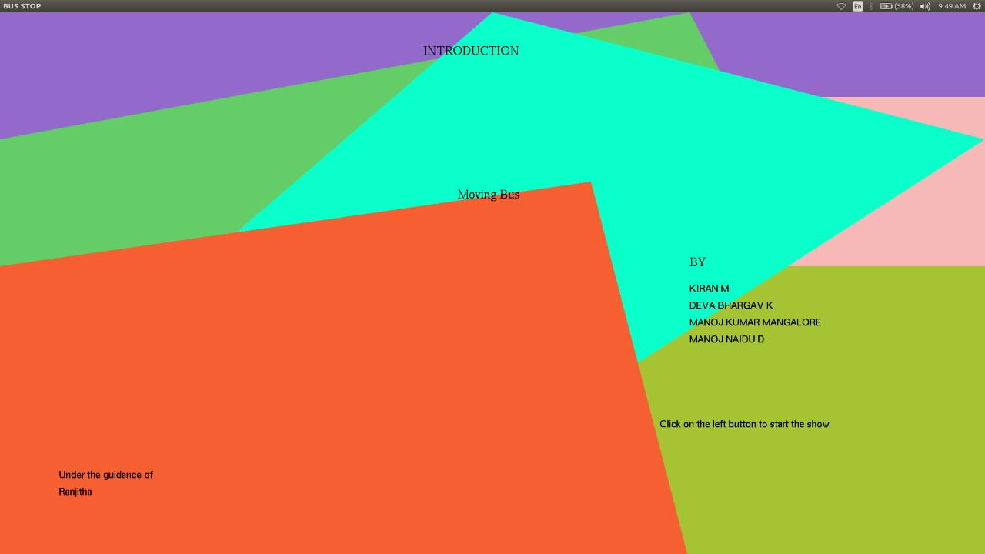
Snapshots:
Fig-1: Start page that gives information about the team members

Slide 12
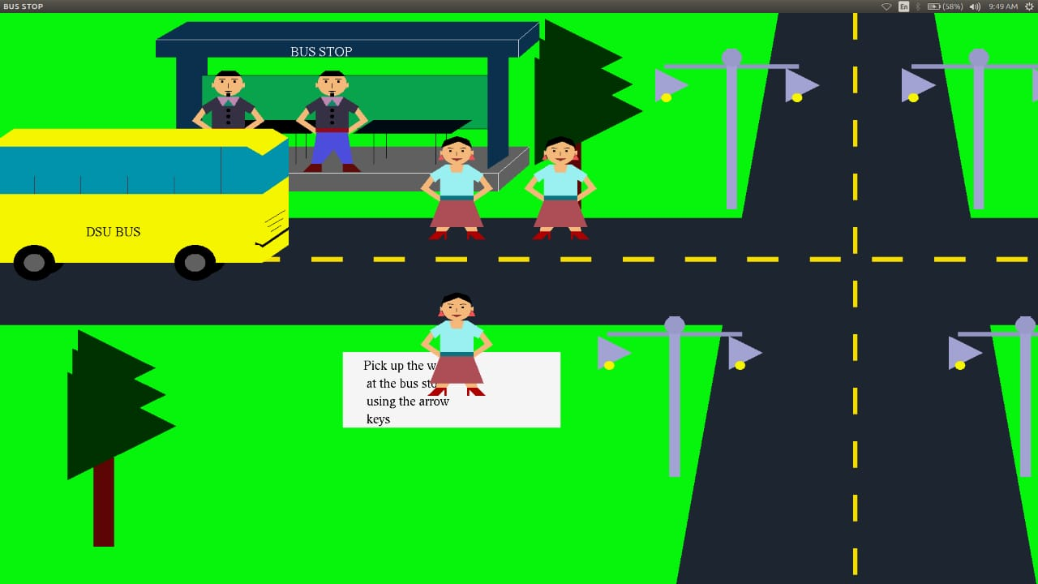
Snapshots:
Fig-2: The first screen of simulation where the bus is approaching the bus stop and passengers waiting to board.

Slide 13
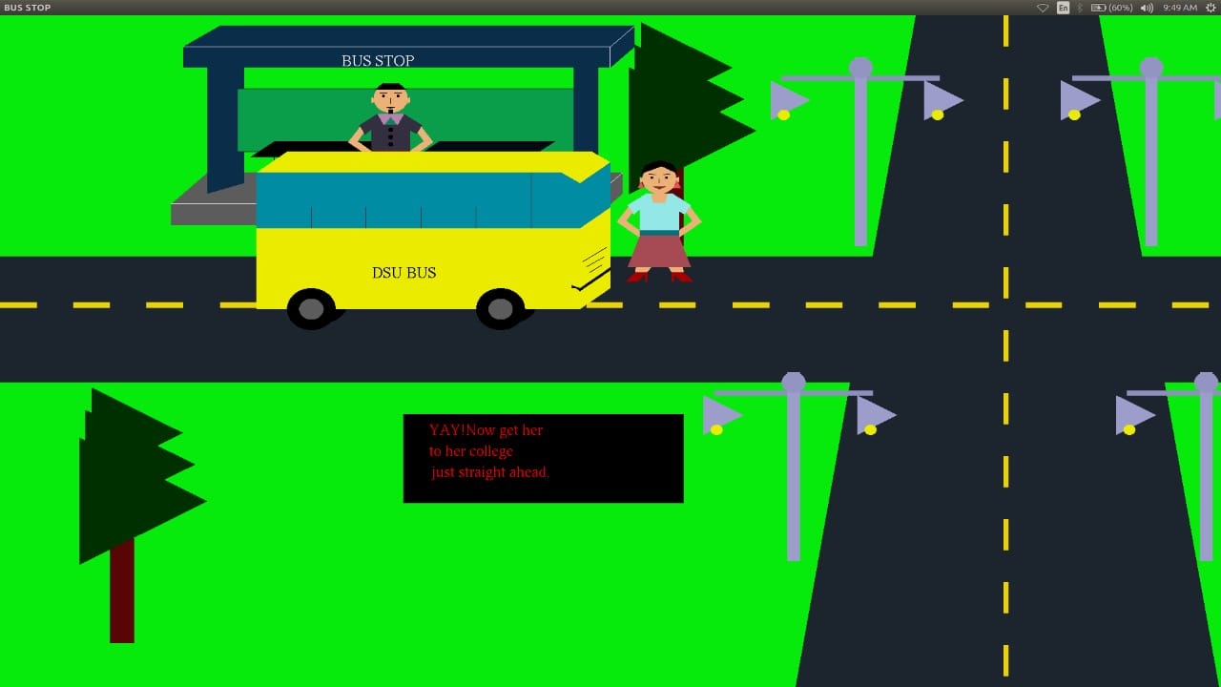
Snapshots:
Fig-3: The bus reached the bus stop and the passengers boarded the bus

Slide 14
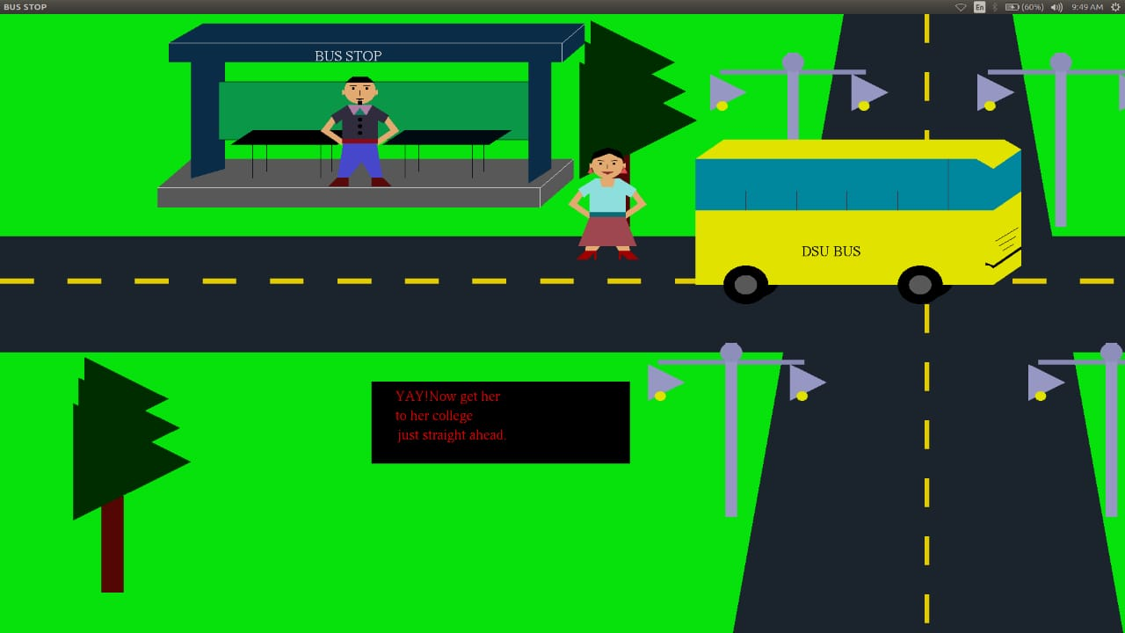
Snapshots:
Fig-4: The bus moving towards the university after everyone boarded the bus.

Slide 15
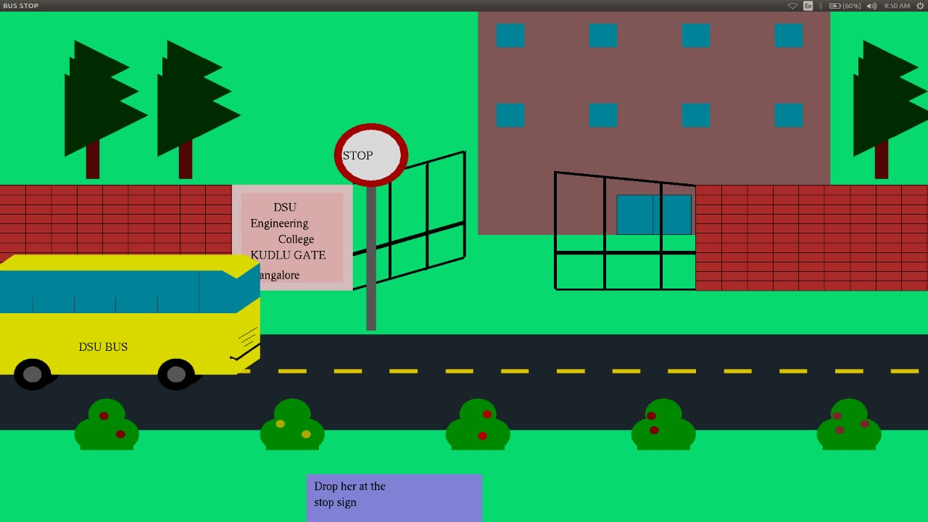
Snapshots:
Fig-5: The bus approaching the university to drop the passengers.

Slide 16
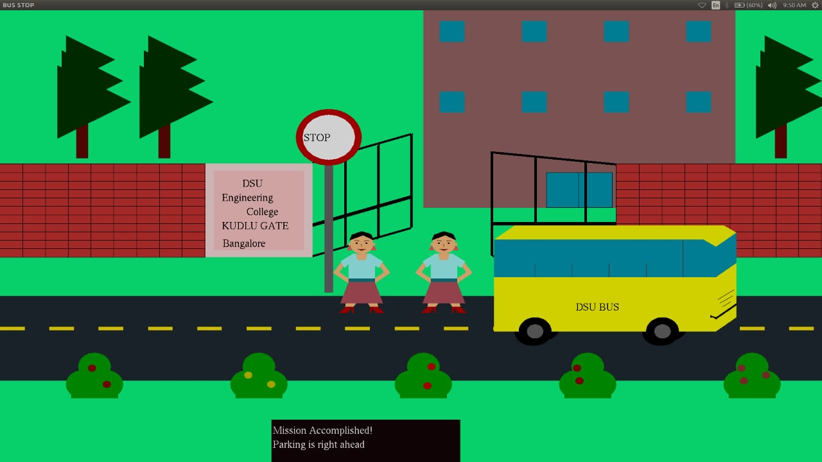
Snapshots:
Fig-6: The passengers deboarded the bus and the bus moving towards the next destination.

Slide 17
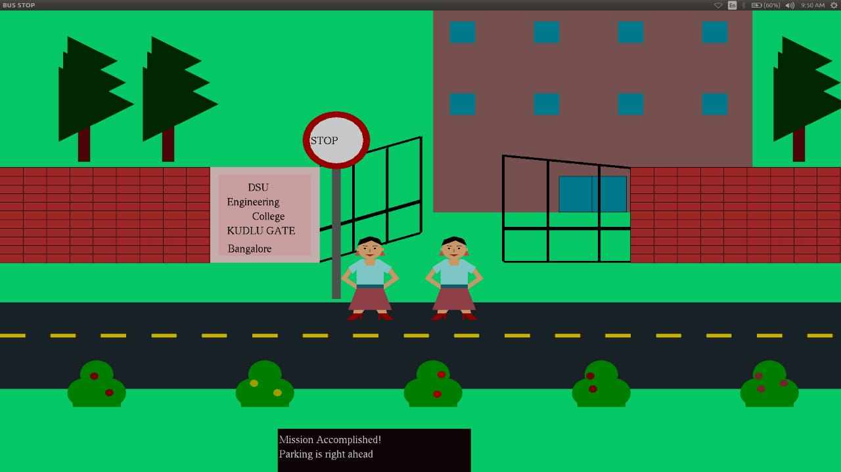
Snapshots:
Fig-7: The bus disappears.

Slide 18
THANK YOU

